Slide 1

CNTK
Deep Learning on Azure
Mike Lanzetta (with much help from the CNTK team)

Slide 2
But First… A Small Disclaimer

Slide 3
I am not a Data Scientist
I am not a Machine Learning Researcher
I’m also not a Machine Learning or Data Science Expert™

Slide 4

So Just To Warn You…
Sometimes my presentation might be like…

Slide 5

But at other times it might appear more like…

Slide 6
The Good News
Since I’m neither a Data Scientist nor a Machine Learning Expert™
You can totally do all of the things I’m doing in this talk
Without having to go back to college
Also, if you wait until the Q&A session
It’ll be incredibly easy to heckle me and trip me up
Enjoy!

Slide 7
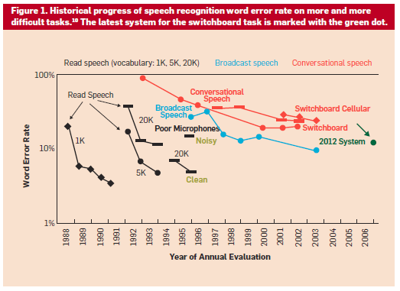
2015 System
Human Error Rate 4%
Notes:
Deep Learning is replacing other more traditional methods for a large number of problems. Most promising are those with a large amount of labeled data available that have some internal (potentially noisy) structure that can be exploited. Speech recognition is one of those areas, and we’ve seen improvements lately that are approaching human level.

Slide 8
ImageNet: Microsoft 2015 ResNet
Microsoft had all 5 entries being the 1-st places this year: ImageNet classification, ImageNet localization, ImageNet detection, COCO detection, and COCO segmentation
Notes:
Image classification and context detection are also tasks that have greatly benefited from deep learning, with the latest Microsoft models winning in five categories. Using deep residual networks of up to 152 layers, these were some of the deepest networks ever.

Slide 9


Slide 10

What is Depp Learning
“I pretty much try to stay in a constant state of confusion just because of the expression it leaves on my face.”
- Johnny Depp

Slide 11
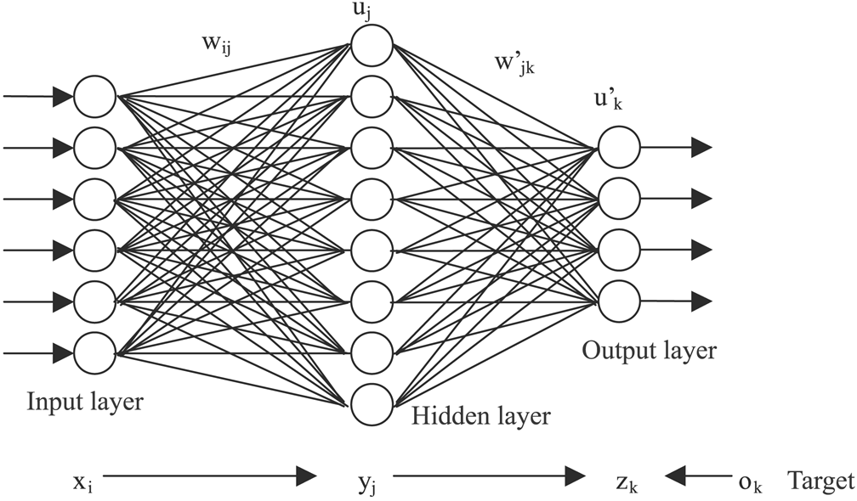
What is Deep Learning, then?
It’s like Machine Learning, only more so
Take a typical “old school” Neural Net
Deep Neural Nets are like that, only with more hidden layers
Maybe 3, or 152
But that’s not quite all…
They’ve dispensed with “layers” and use the glory of Tensors
They’ve traded in simple “neurons” for more complex ones

Slide 12

Deep Learning Examples

Slide 13
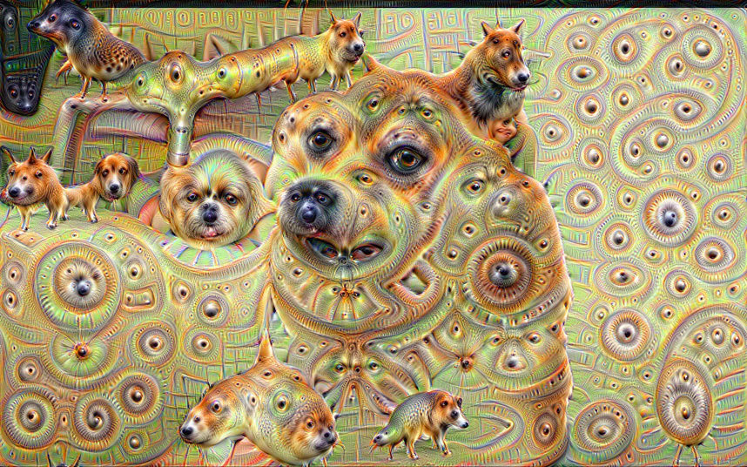
Deep Learning Examples

Slide 14
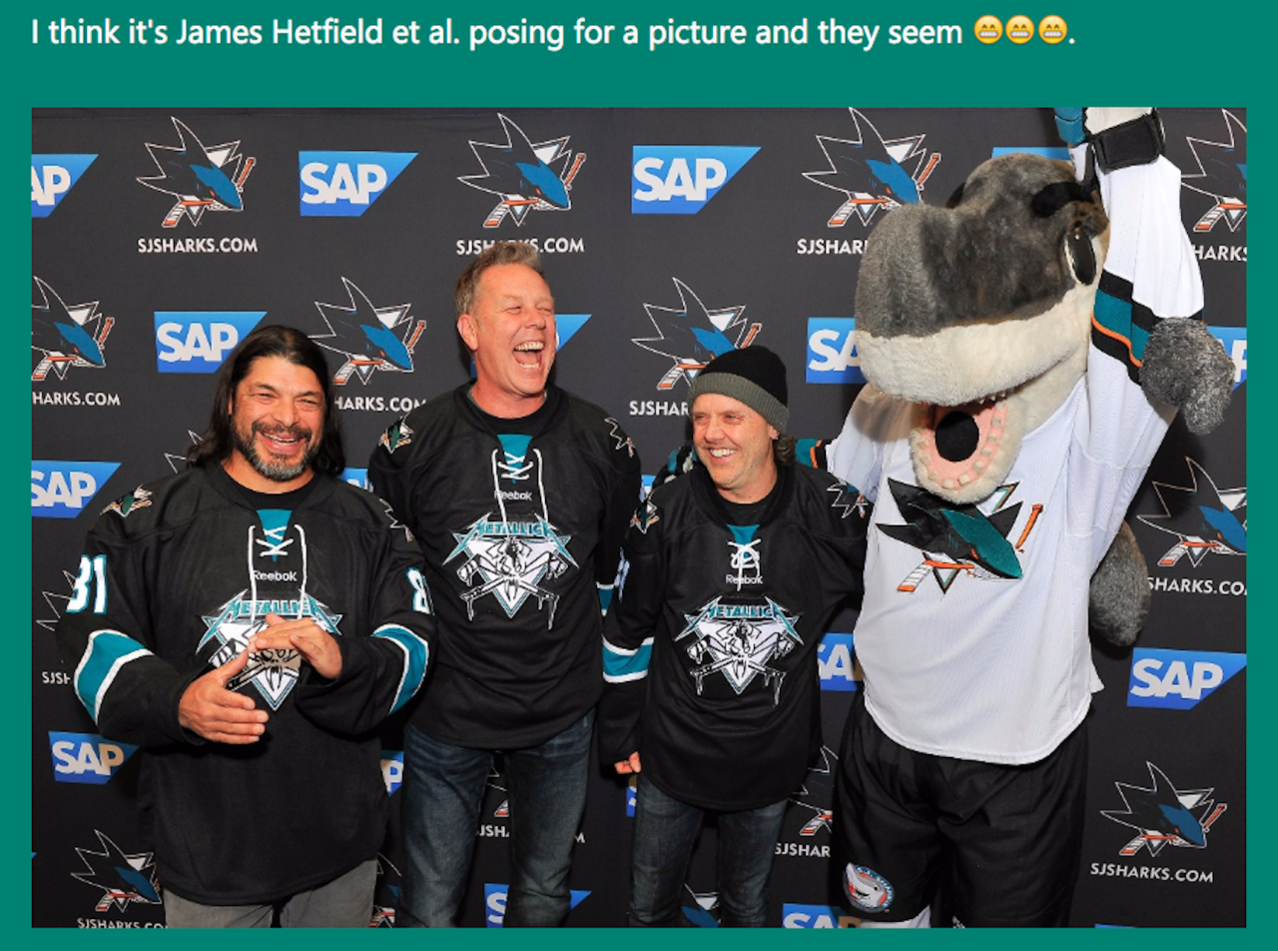
Deep Learning Examples

Slide 15
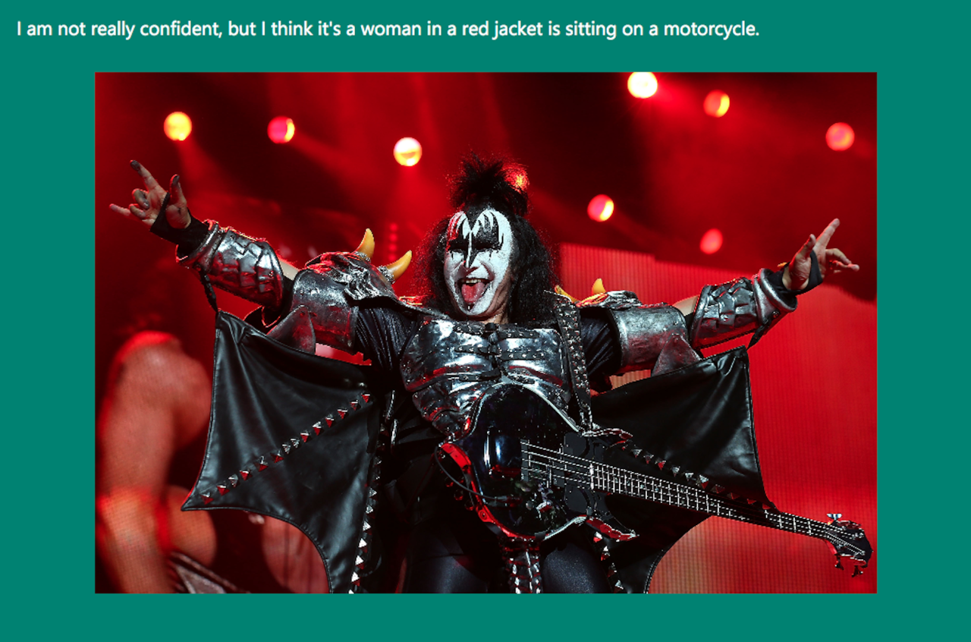
Deep Learning Examples

Slide 16
Computational Networks
Layered Networks
A series of computational steps, set up as “layers”
Each layer L has full forward connectivity to L+1
Edges have weights, “back-prop” learns those weights
Computational Networks
Generalized “layer” connections into Directed Graph
Edges still have weights
No longer is full forward connectivity required, allows sparsity
“Sideways”, “Backward” and other connectivity allowed

Slide 17
Deep Network Flavours - CNN
Not the news network – they’re not that deep
Convolution (that’s the C) layers convolve input to produce smaller output, reducing dimensionality while keeping state
Subsampling layers further reduce dimensionality, and can provide some position invariance
Max pooling is the most common for CNNs
The general idea is you stack these so that after one layer you’re saying “this is an edge” and by layer 4 you’re saying “this is a dog on a unicycle”

Slide 18
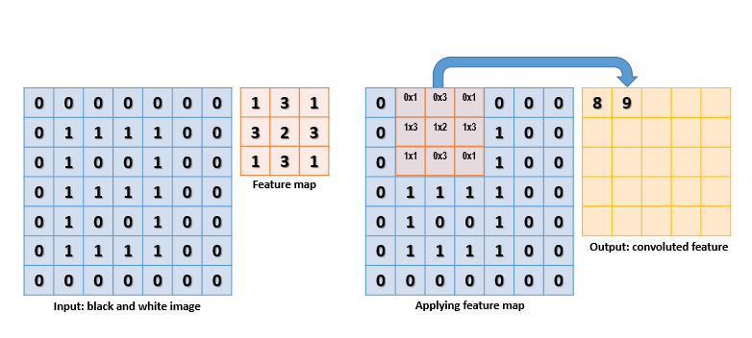
Deep Network Flavours - CNN
Convolution In Action
Input dot-products with a feature map to generate a value
The feature map “strides” across the input until finished

Slide 19

Deep Network Flavours - CNN
Max-Pooling In Action
A 2x2 pooling layer
Vertical and Horizontal Stride of 2
Picks the max of
its area of interest
and propagates
that value

Slide 20
Deep Network Flavours - RNN
Recurrent Neural Networks are loopy
No, really, they have loops – feeding back their outputs into their internal (hidden) state
They are, at times, unreasonably effective
They also have a tendency to explode (or implode)
By default, they are influenced by all input they’ve ever seen
This leads to vanishing/exploding gradients
This can be mitigated
LSTMs are RNNs that have a “spotty” memory
Residual NNs propagate … residuals

Slide 21

Deep Network Flavours - RNN
https://colah.github.io/posts/2015-08-Understanding-LSTMs/ is a great primer (image on this slide from there)
Recurrence drives the output from one iteration into the input of the next

Slide 22
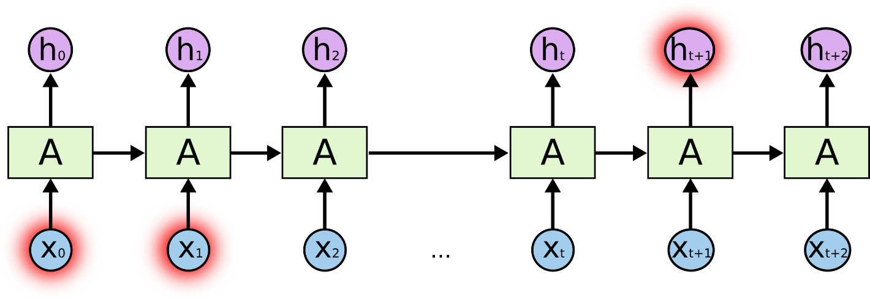

Deep Network Flavours - LSTM
RNNs with long memories can “explode/implode”
LSTMs tackle this by having gated memory cells

Slide 23
Deep Networks – Moar
DSSM – Deep Semantic Similarity Model
Great for modeling semantic relationships in text
CNNs for Text
Convolutions over sentences can be considered “weighted n-grams”
RNNs for Images
DeepMind’s Visual Attention Model

Slide 24
CNTK Overview
A deep learning tool that balances
Efficiency: Can train production systems as fast as possible
Performance: Can achieve state-of-the-art performance on benchmark tasks and production systems
Flexibility: Can support various tasks such as speech, image, and text, and can try out new ideas quickly
Inspiration: Legos
Each brick is very simple and performs a specific function
Create arbitrary objects by combining many bricks
CNTK enables the creation of existing and novel models by combining simple functions in arbitrary ways.
MIT Licensed OSS on GitHub

Slide 25
Functionality
Supports
CPU and GPU with a focus on GPU Cluster
GPU (CUDA): uses NVIDIA libraries, including cuDNN v5.
Windows and Linux
automatic numerical differentiation
efficient static and recurrent network training through batching
data parallelization within and across machines with 1-bit quantized SGD
memory sharing during execution planning

Slide 26
Functionality
Modularized: separation of
computational networks
execution engine
learning algorithms
model description
data readers
Models can be described and modified with
Network definition language (NDL) and model editing language (MEL)
Python, C++ and C# (in progress)

Slide 27
CNTK Architecture
CPU/GPU
IExecutionEngine
CN Description
Builder Lambda
CN
Use
Build
Evaluate
Compute Gradient
Features & Labels
IDataReader
ILearner
Load
Get data
Task-specific reader
SGD, AdaGrad, etc.

Slide 28
Main Operations
Train a model with the train command
Evaluate a model with the eval command
Edit models (e.g., add nodes, remove nodes, change the flag of a node) with the edit command
Write outputs of one or more nodes in the model to files with the write command
Finer operation can be controlled through script languages (beta)

Slide 29
At the Heart: Computational Networks
Representation:
A list of computational nodes denoted as
n = {node name : operation name}
The parent-children relationship describing the operands
{n : c1, · · · , cKn }
Kn is the number of children of node n. For leaf nodes Kn = 0.
Order of the children matters: e.g., XY is different from YX
Given the inputs (operands) the value of the node can be computed.
Can flexibly describe deep learning models.
Adopted by many other popular tools as well

Slide 30
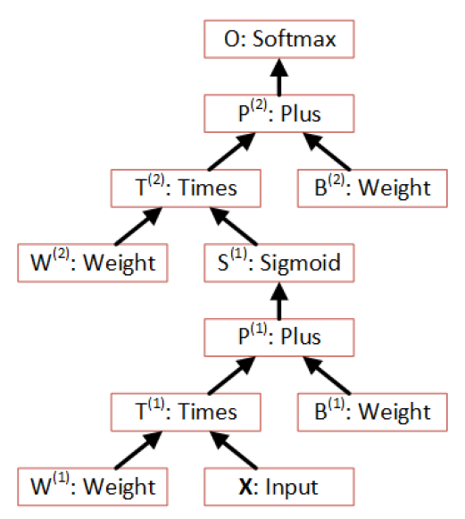
Example: One Hidden Layer NN
O
Output
Layer
Softmax
P⁽²⁾
W⁽²⁾, b⁽²⁾
S⁽¹⁾
Hidden
Layer
Sigmoid
P⁽¹⁾
W⁽¹⁾, b⁽¹⁾
X

Slide 31
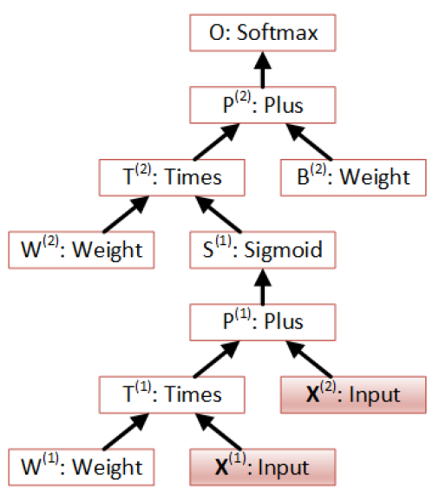
Example: CN with Multiple Inputs

Slide 32
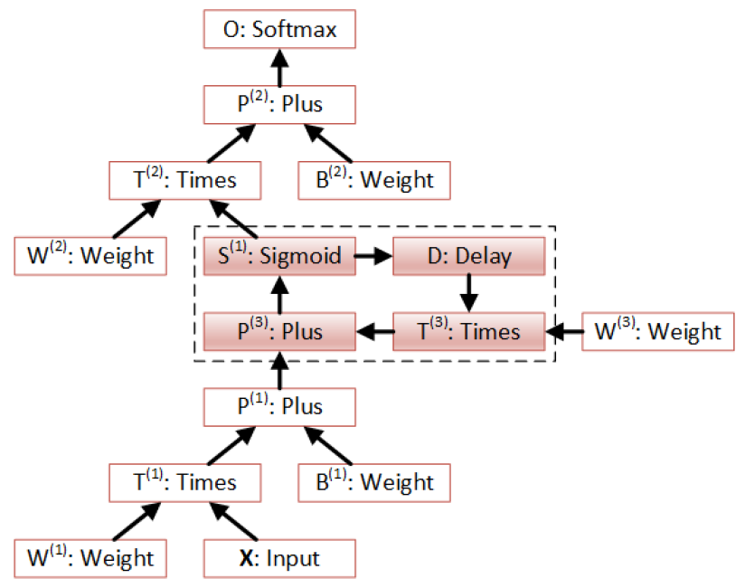
Example: CN with Recurrence

Slide 33
Usage Example (with Config File)
cntk configFile=yourConfigFile DeviceNumber=1
command=Train:Test
Train=[
action = "train"
deviceId=$DeviceNumber$
modelPath=“$your_model_path$
NDLNetworkBuilder=[…]
SGD=[…]
reader=[…]
]
String Replacement
CPU: CPU
GPU: >=0 or auto
You can also use C++, Python and C# (work in progress) to directly instantiate related objects.

Slide 34
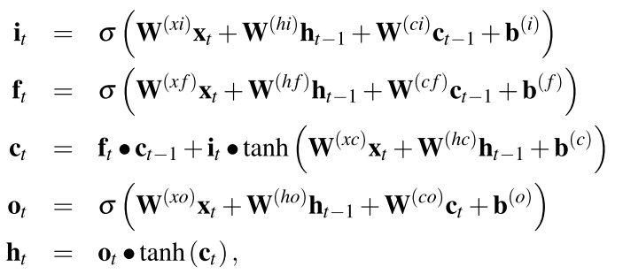
LSTM Definition with NDL
LSTMComponent(inputDim, outputDim, inputVal) = [
… define Wxi, Whi etc. for weight matrices …
delayH = PastValue(outputDim, output, timeStep=1)
delayC = PastValue(outputDim, ct, timeStep=1)
WxiInput = Times(Wxi, inputVal)
WhidelayHI = Times(Whi, delayH)
WcidelayCI = DiagTimes(Wci, delayC)
it = Sigmoid (Plus ( Plus (Plus (WxiInput, bi), WhidelayHI),
WcidelayCI))
WhfdelayHF = Times(Whf, delayH)
WcfdelayCF = DiagTimes(Wcf, delayC)
Wxfinput = Times(Wxf, inputVal)
ft = Sigmoid( Plus (Plus (Plus(Wxfinput, bf), WhfdelayHF),
WcfdelayCF))

Slide 35
CNN Definition with NDL
Convolutions (2D and ND)
Simple Syntax for 2D convolutions:
ConvReLULayer(inp, outMap, inWCount, kW, kH, hStride, vStride, wScale, bValue)
[
W = LearnableParameter(outMap, inWCount, init = Gaussian, initValueScale = wScale)
b = ImageParameter(1, 1, outMap, init = fixedValue, value = bValue)
c = Convolution(W, inp, kW, kH, outMap, hStride, vStride, zeroPadding = true)
p = Plus(c, b)
y = RectifiedLinear(p)
]
conv2 = ConvReLULayer(pool1, 32, 800, 5, 5, 1, 1, conv2WScale, conv2BValue)
Reusable macro
Macro usage

Slide 36
Model Editing with MEL
Insert a new layer (e.g., for discriminative pretraining)
CE.S=Softmax(CE.P)
CE.P=Plus(CE.T,bO)
CE.T=Times(WO*L2.S)
MODIFY
MEL
L2.S=Sigmoid(L2.P)
L2.P=Plus(L2.T,bO)
L2.T=Times(W2,L1.S)
CREATE
CE.S=Softmax(CE.P)
CE.P=Plus(CE.T,bO)
CE.T=Times(WO,L1.S)
L1.S=Sigmoid(CE.P)
L1.P=Plus(L1.T,b1)
L1.T=Times(W1,X)
L1.S=Sigmoid(CE.P)
L1.P=Plus(L1.T,b1)
L1.T=Times(W1,X)
X
X

Slide 37
Computation: Without Loops
Given the root node, the computation order can be determined by a depth-first traverse of the directed acyclic graph (DAG).
Only need to run it once and cache the order
Can easily parallelize on the whole minibatch to speed up computation

Slide 38
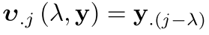
With Loops (Recurrent Connections)
Very important in many interesting models
Implemented with Delay (PastValue or FutureValue) node
Naive solution:
Unroll whole graph over time
Compute sample by sample

Slide 39
With Loops (Recurrent Connections)
A smart algorithm analyzes the network and
Finds loops
Does mini-batch computations on everything except loops
Group multiple sequences with variable lengths
This gives better convergence than tools that only support batching of same length sequences
Users just describe computation steps. Speed up is automatic

Slide 40
CNTK = Cinderella NTK?
CNTK Computational Performance
*Well, there are workarounds, but they’re new, not easy or as efficient

Slide 41
CNTK: The Bad and Ugly
Minute to Learn, Lifetime to Master
Documentation is sparse, targeted at experts
Some of the loaders require domain knowledge
Examples are … sparse
Bifurcated Workflow
No Python or R binding
Data preparation/featurization separate step
Custom code required for non-standard input
Support on Azure
Runs in Data Scientist VM, Docker, etc. but…
Lack of GPU support limits utility
Standing up a trained model as a service takes effort

Slide 42
CNTK 2.0
CNTK as a library
C++, Python and .NET bindings
Allows creation of new nodes as well as new network types
Sequence-to-Sequence with attention models
Blockwise Model Update Filtering (BMUF) (1)
Reinforcement Learning
Performance improvements
(1) Kai Chen and Qiang Huo, “Scalable training of deep learning machines by incremental block training with intra-block parallel optimization and blockwise model-update filtering”,
in Internal Conference on Acoustics, Speech and Signal Processing , March 2016, Shanghai, China.

Slide 43
Summary
CNTK is powerful
Supports GPU/CPU
Runs on Linux and Windows
CNTK is extensible
Adding new readers and computation nodes is easy
CNTK is DSL-based
NDL makes defining networks easy
MEF makes modifying them easy as well
DSL means no falling back on e.g. Python for help

Slide 44
Additional Resources
CNTK:
https://github.com/Microsoft/CNTK
Contacts:
CNTK team: ask a question on CNTK GitHub!
Mike:
Email: milanz@microsoft.com
Twitter: @noodlefrenzy
Alexey:
Email: alexey.kamenev@microsoft.com
Thanks to Alexey and the CNTK team for large parts of this presentation

Slide 45
Q&A

Slide 46
Azure GPU - Coming Soon
High performance deep learning platform on Azure
Scalable to hundreds of NVIDIA GPUs
Rapid, no-hassle, deep learning experimentation
Larger models and training data sets
Multitenant
Fault tolerant
Open source friendly
CNTK optimized
3rd party accessible (coming)
The project has been running internally for 6+ months with great success

Slide 47

Azure GPU Architecture
Job submit job monitor
Node0 GPU0,1,2,3
Node1 GPU0,1,2,3
Node2 GPU1
Node2 GPU2
…
Web
Portal
CNTK
CNTK
CNTK
CNTK
Data Ingress / Egress
JobA User0
JobA User0
JobB User1
JobC User2
REST API
Docker (Ubuntu Distribution)
Samba
YARN (Job/Container Scheduling, Resource Management)
FUSE
HDFS (Distributed Storage)
CoreOS

Slide 48
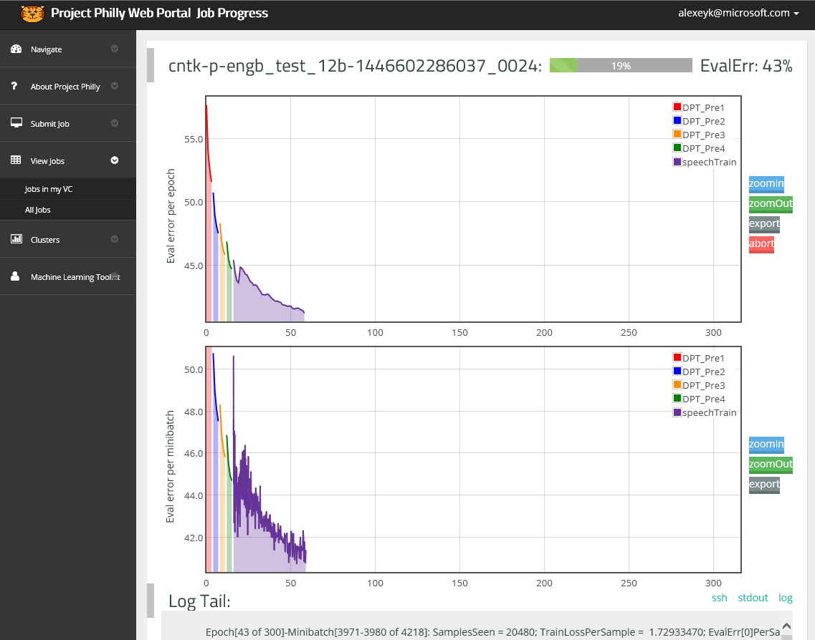
Azure GPU Job Monitoring

Slide 49
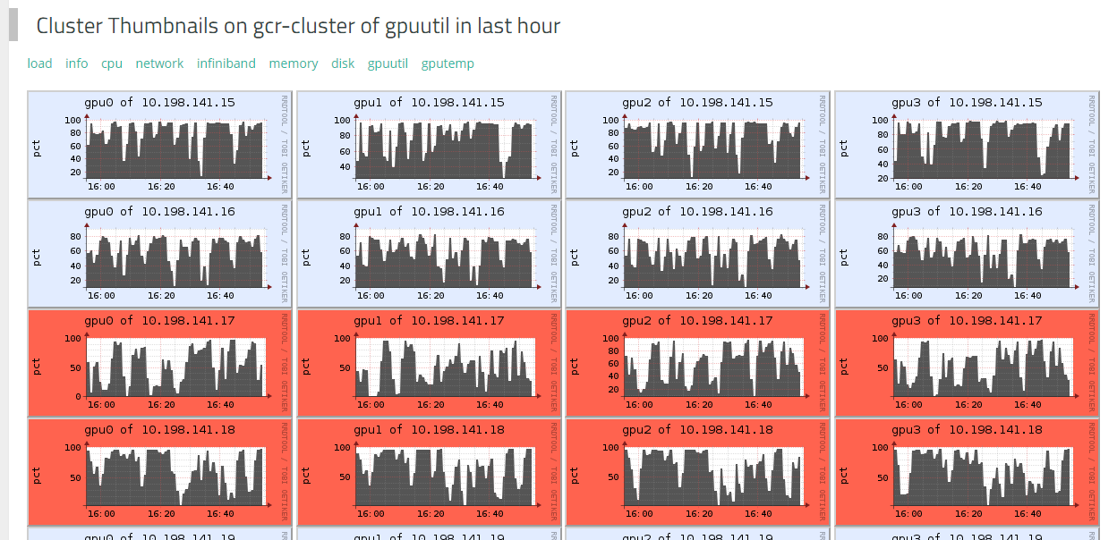
Azure GPU Cluster Monitoring

